Slide 1

Identifying Pollution Hotspots in New Jersey
By The Data Questers: Meena Vellala, Emily Schneider, Arielmy Morel, Brendan Doucette, and Ava Davis
Notes:
Arielmy

Slide 2

Why Are We Looking at Air Quality?
Notes:
Meena: Air pollution has severe health impacts in cities around the world. Together with the connected issue of climate change, the WHO recognises air pollution as the biggest global health threat in the current century.Every year, exposure to ambient air pollution is estimated to cause around 4.5 million premature deaths globally, and indoor air pollution causes a further 2.3 million
How does the US rank in the world air pollution and where does NJ stand in the US? - As of 2024, the United States ranks as the 18th most polluted country globally, with an average PM2.5 concentration of 8.0 μg/m³. Although the overall air quality has seen improvements due to regulations like the Clean Air Act, the country still faces significant challenges, particularly due to climate change and wildfires that have contributed to spikes in particle pollution.Within the U.S., New Jersey has a mixed air quality profile.

Slide 3
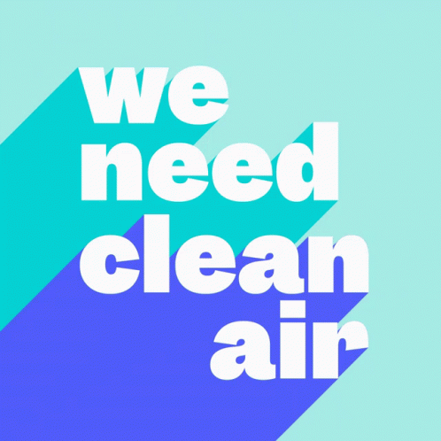
What counties in NJ show higher levels of air pollution? Why do these areas have the high rates of pollution that they do?
Notes:
Ava

Slide 4
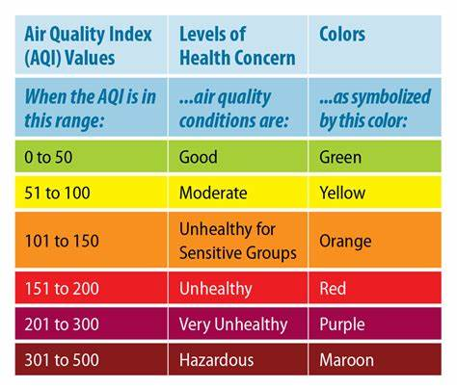
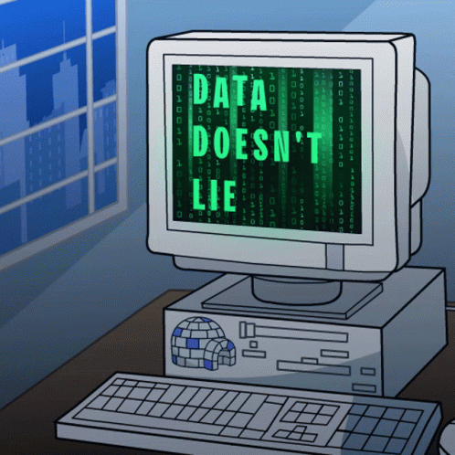
What Data Did We Utilize?
Notes:
Emily: Daily AQI across all counties in New Jersey from 2018-2023, includes defining parameters, which includes:
Particulate Matter
Carbon Monoxide
Ozone
Nitrogen Dioxide
Sulfur Dioxide
The AQI identifies the level of certain Greenhouse Gasses (GHGs), such as the ones mentioned above.
Construction, auto emissions, smoking, electronic devices, etc. all contribute to different defining parameters for the daily AQI.

Slide 5
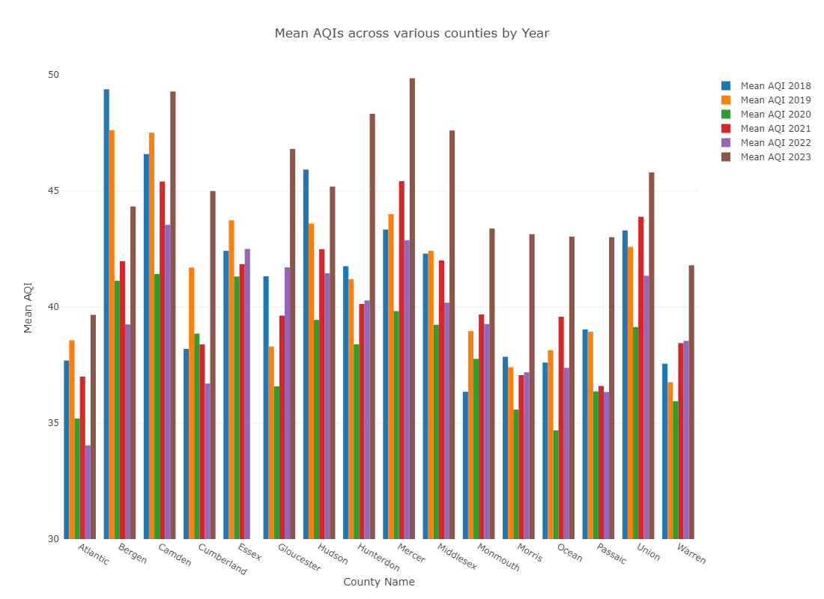
NJ Air Quality: A general overview
,
..
Notes:
Meena: This graph illustrates the mean AQI in each county in NJ over the span of five years. Viewers are able to see the average AQI, year by year, and whether they are increasing, decreasing, or staying the same. Conclusions on the cause of the change can be drawn with further evidence.
Besides Essex County’s lack of data for 2023, the average AQI ranges from 30-50, which fortunately for us, consistently falls in the green.
Arrows are pointing towards counties with increasing mean AQIs: Bergen, Camden, Mercer, Middlesex, Monmouth and Union.

Slide 6
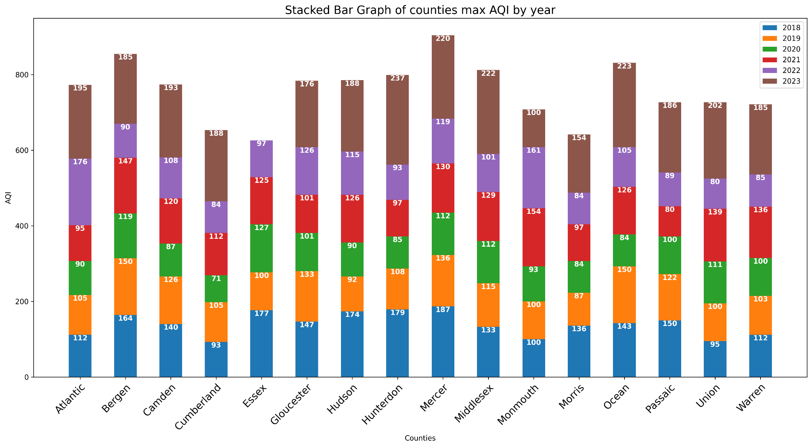

Counties with the worst air quality (maybe don’t move here)
Notes:
Brendan: The graph presented illustrates the max AQI values by each year in each county in NJ. Y axis is cumulative. We can see dips in 2020
We could say counties with the worst air quality are Bergen, Mercer, Camden, Ocean, and Middlesex.

Slide 7
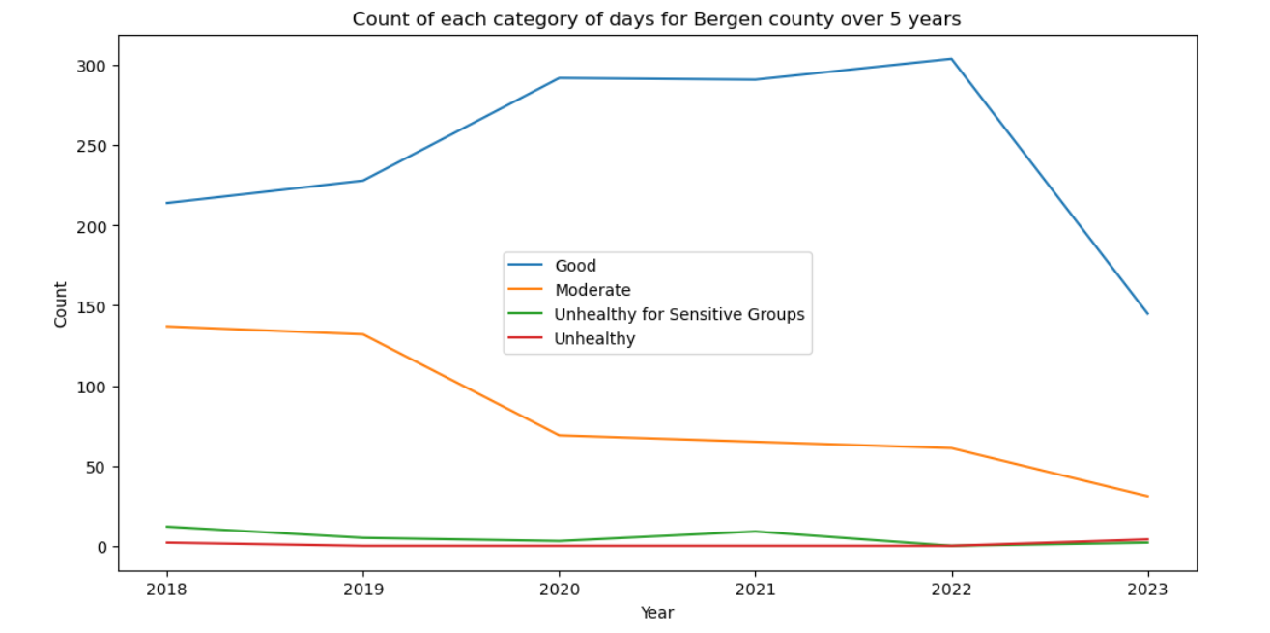
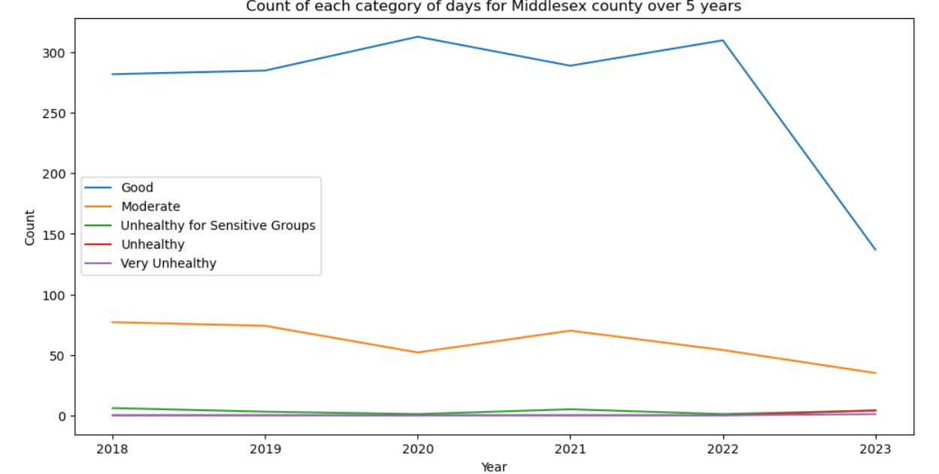
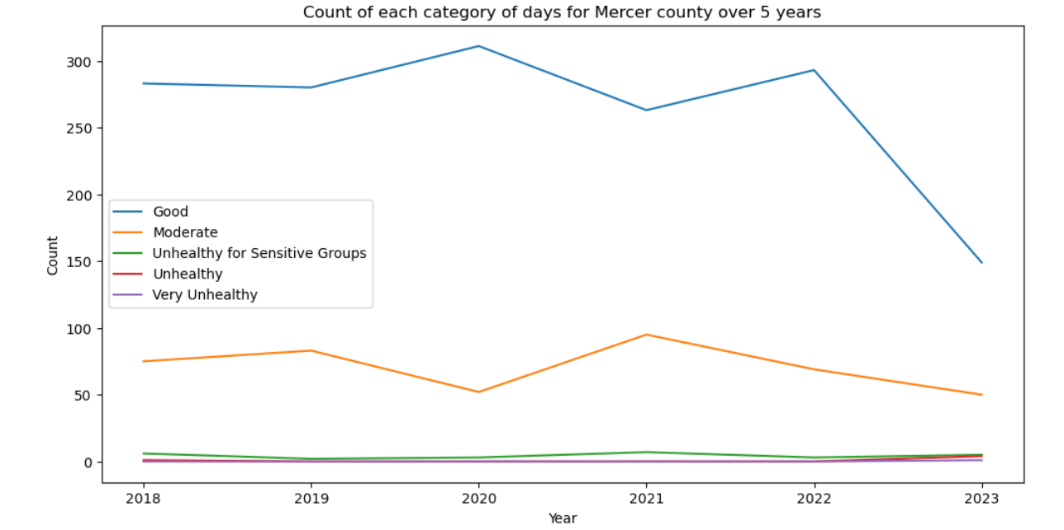
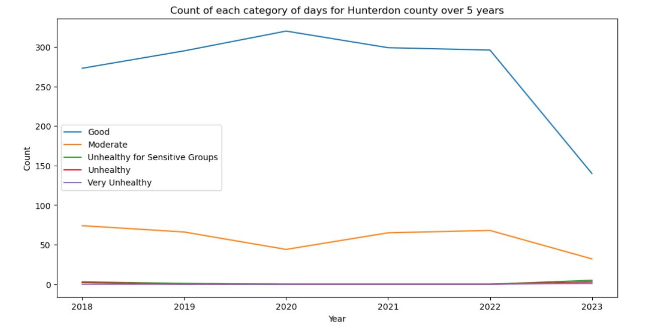
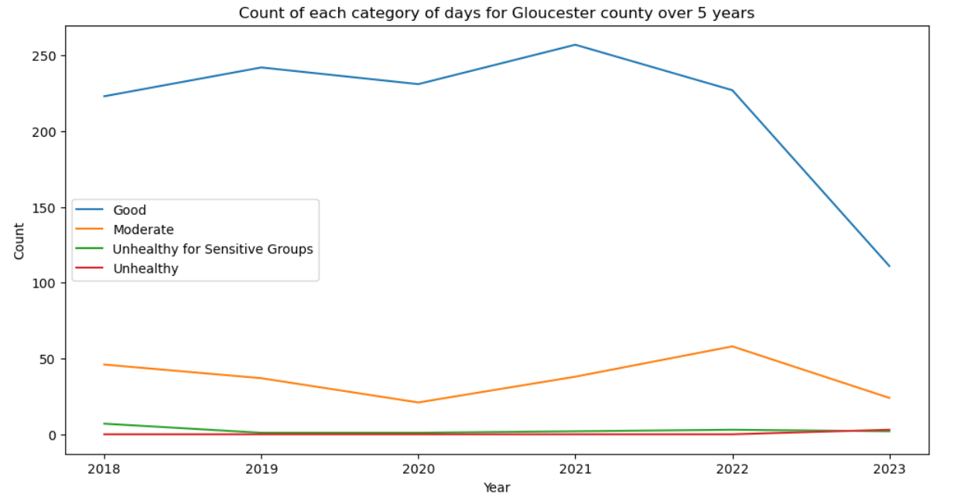
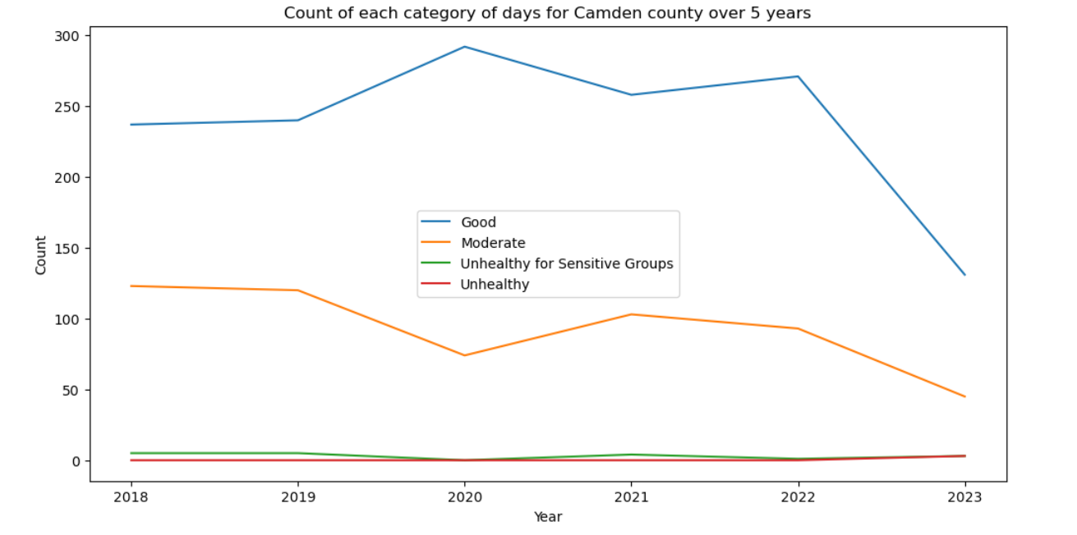
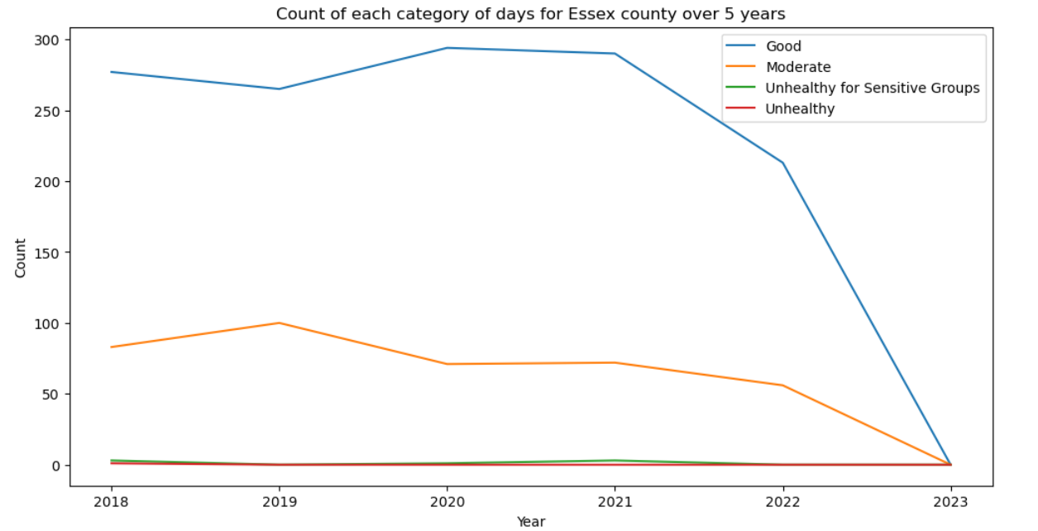
Comparing Categories
of the AQI
Bergen
Middlesex
Mercer
Hunterdon
Gloucester
Camden
Essex
Notes:
Arielmy: Focused on counties with high mean and mx AQI scores each year and wanted to see breakdown on these 6 counties over time to see if there were any trends in category counts per year/per county. Overall most days were good, 2nd largest were moderate, and concerning scores were much smaller.
Work and Visualization Done: Calculated count of each type of day (ex. Good, moderate, etc.) for each of 7 counties across a 5 year period. Visualization: line plots across 5 year period for 7 selected counties to track count of each AQI score category for each day that year.
Answer: Even the 7 selected concerning counties have by far more good and moderate days that the other more concerning category days. The trends for these 7 counties also seems similar to the overall trend for the state of NJ. Multiple of the 7 counties did not have high level concern (ex. Very unhealthy and hazardous) days. Most of the 7 counties (aside from Essex and Gloucester) had uptick in Good days from 2021 to 2022. It should be noted that some counties like Essex did not have data for 2023 and others did not have full 365 days for 2023.

Slide 8
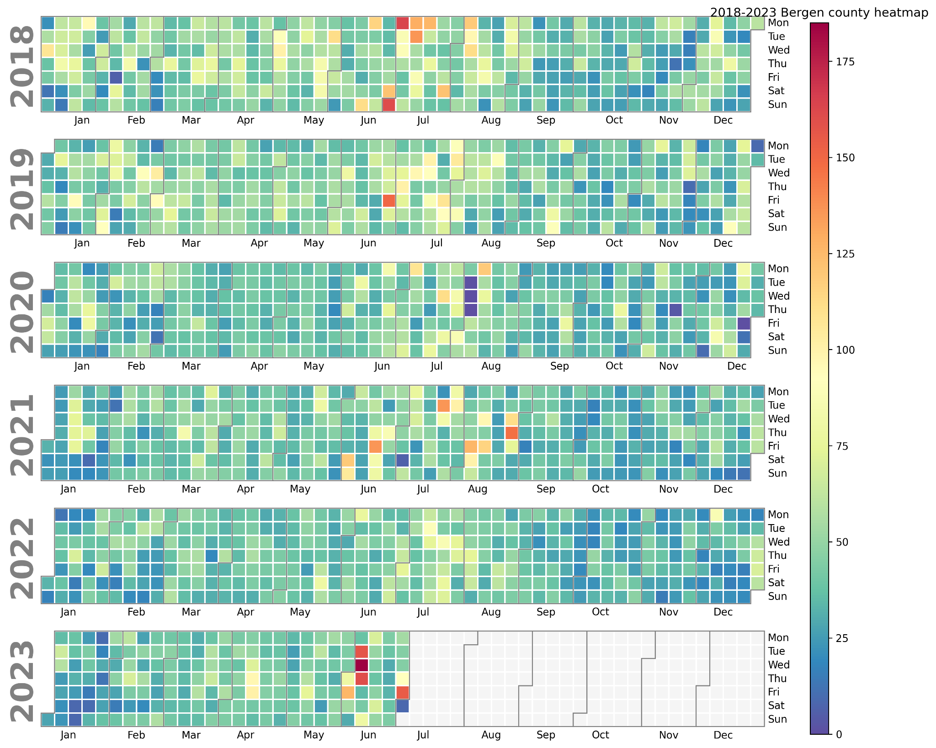
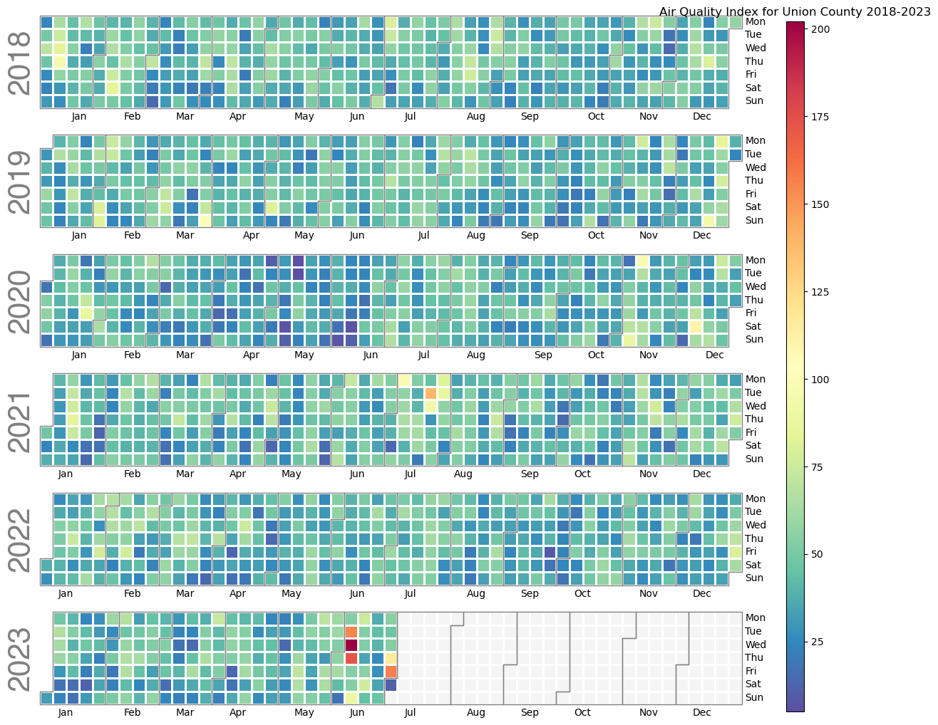
Heat Map of High AQI Counties(Bergen vs Union)
Notes:
Brendan

Slide 9

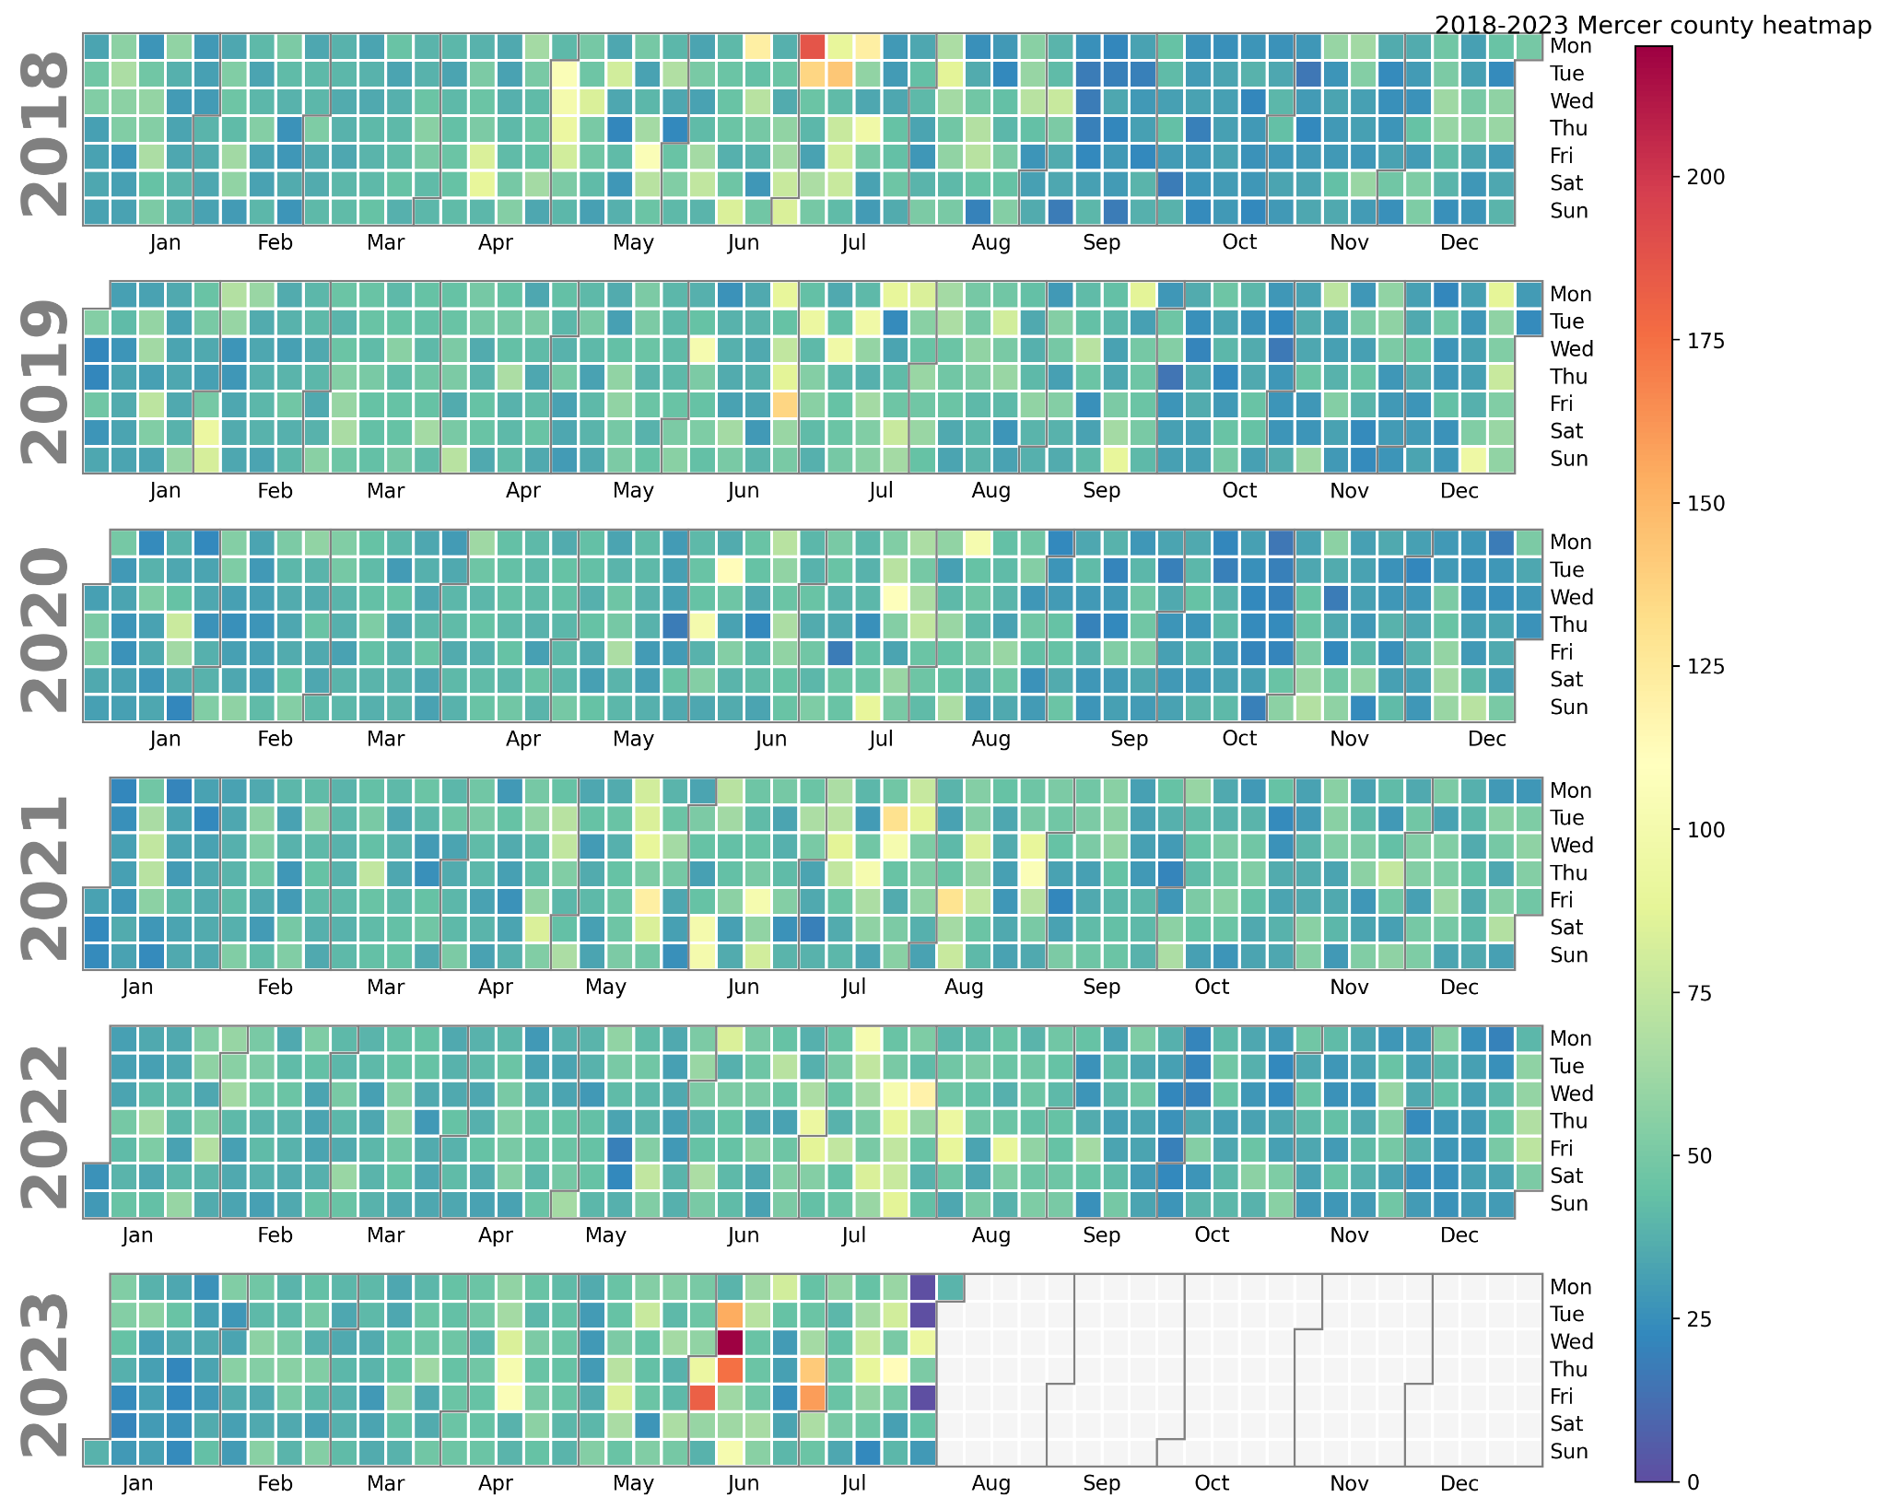
Heat Map of High AQI Counties (Mercer vs Hunterdon)
Notes:
Emily: These two sets of heat maps display the daily AQI in Hunterdon County vs. Mercer County, with the scale showing that the bluer the box, the lower the AQI. As shown in both graphs, most of the days illustrated in these graphs remain pretty low on the scale, with a cluster of dates in 2023 showing higher AQI’s (wildfires).

Slide 10
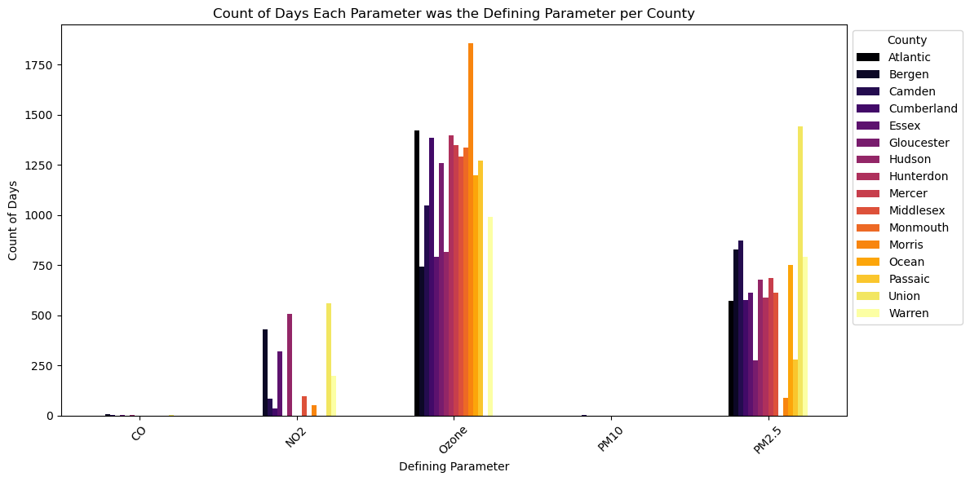
Distribution of Pollutants
[emily’s stacked bar chart per pollutant]
Notes:
Emily: This graph was made to show the distribution of all pollutants noted in the datasets used across each county. It uses the total number of days each one was the defining parameter in each respective county, which are differentiated by the gradient colors.

Slide 11
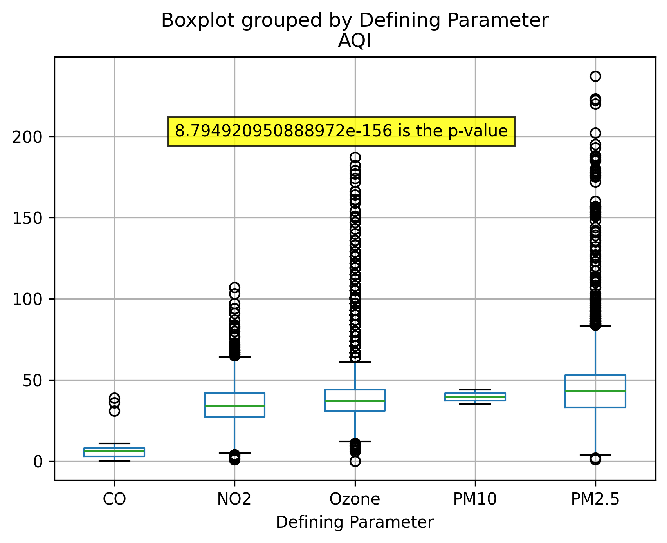
ANOVA test of the Parameters on AQI
Notes:
Brendan

Slide 12
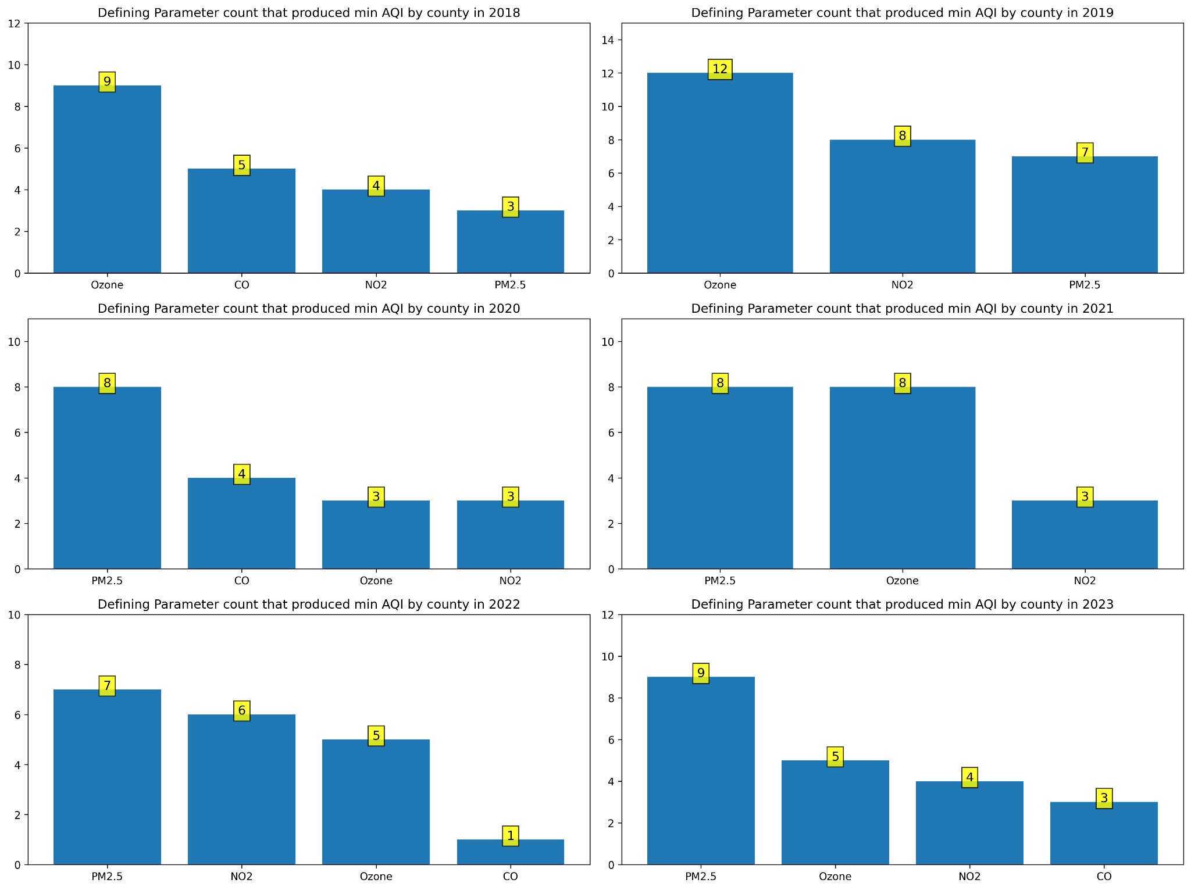
Parameters Impacting Minimum values
Notes:
Brendan

Slide 13
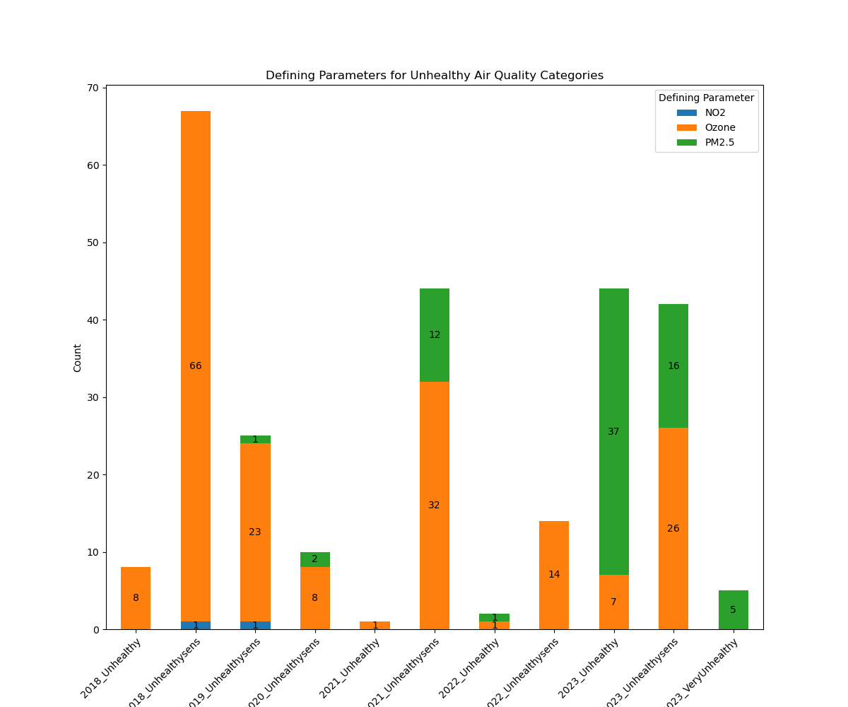
Identifying Parameters Contributing to Unhealthy Air Quality Days in New Jersey
PM2.5 is primary pollutant…
Notes:
Meena:
Over the 6-year period we analyzed, we noticed a rise in PM2.5 values contributing to the number of unhealthy, unhealthy for sensitive groups, and very unhealthy days. Previously, ozone was the primary contributor, but it appears that the trend is shifting.

Slide 14
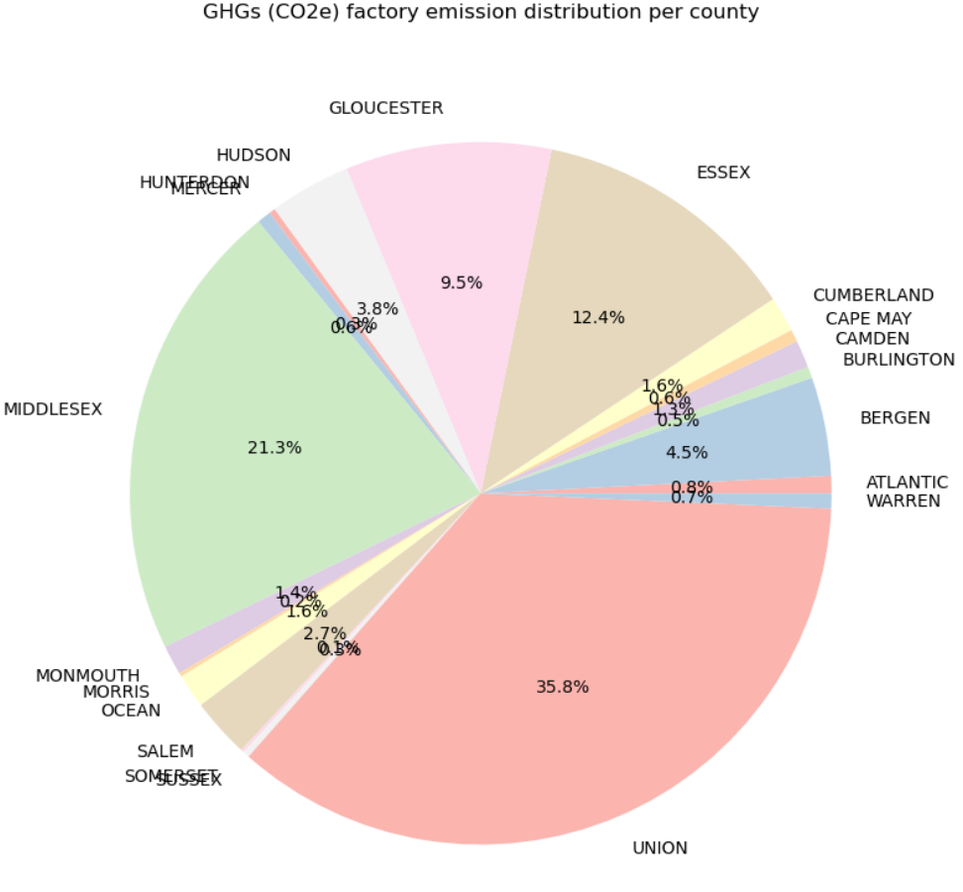
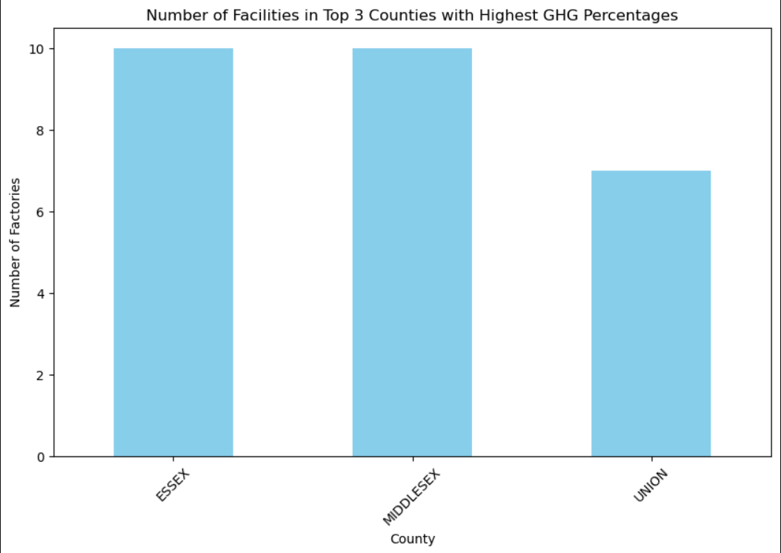
Potential Contributing Factors
[add ava’s GHGs factories graphs]
Notes:
Ava: This is based off of the EPA’s Facility Level Information on Greenhouse Gasses, mostly waste disposal (33) and powerplants(19)

Slide 15

Final Observations
Amongst 16 NJ counties in dataset, 7 counties had mean and max AQIs above the others.
Overall Good and Moderate and relatively less unhealthy days.
There seems to be relationship between Defining Parameters and AQI scores
Ozone and PM2.5 highly contributed to defining parameter count; PM2.5 seemingly more relevant over time than Ozone as PM2.5 contributed more to unhealthy category.
Most of the unhealthy days were during summertime; potential to dig deeper (ex. Temp, human activities, fires, etc.)
Some counties with top GHG emissions did not appear in top AQI score list, likely due to type of emission
Though not cause for major concern now, still keep an eye on air quality!
Climate change is still a thing!
Notes:
Arielmy: CO2 not frequent defining and often correlated with minimum AQIs but can indirectly add to PM2.5 via smog.

Slide 16
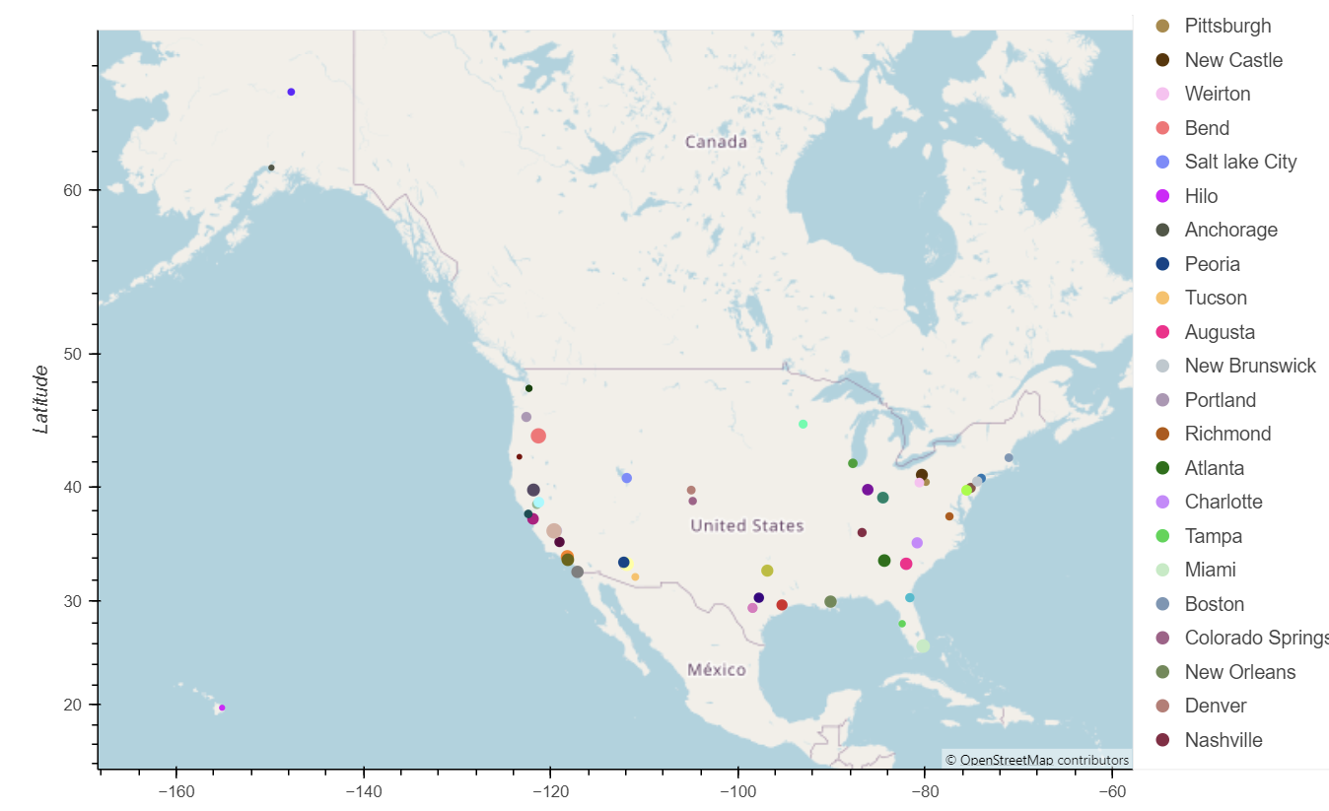
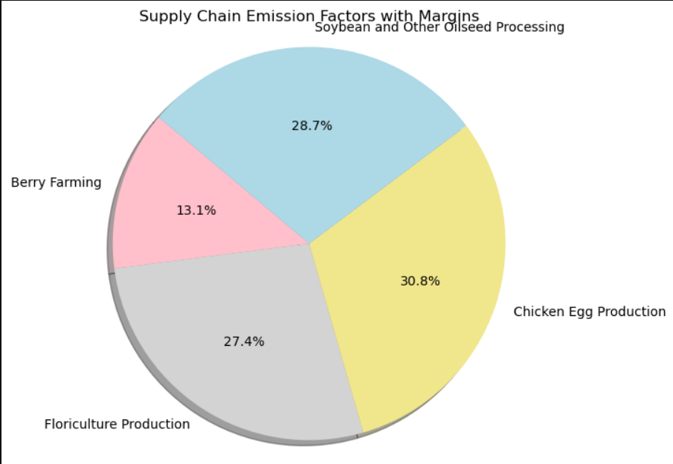
Potential Impacts/Advancements
Notes:
Ava: These are the top four agricultural industries in NJ,
Meena: We observed the real time air quality data for few cities in the US and saw that many cities in the California region, Utah, Arizona, we would like to expand our dataset outside of NJ and understand the contributing factors
Potential health impacts of air pollution in NJ (ex. Lung-related illness rates)
More potential influencing factors to AQI score in NJ (ex. Transportation, population density, migration within NJ, proximity to airports)
Explore other areas in USA with concerning air quality and potential contributing factors.
Predictive modeling eventually (machine learning)

Slide 17

Sources
Data Sources: https://aqs.epa.gov/aqsweb/airdata/download_files.html#AQI
API : https://aqicn.org/api/
New Library: Calplot, Plotly
https://aqicn.org/json-api/doc/
Greenhouse Gas Emissions from Large Facilities (up to 2022)
Supply Chain Greenhouse Gas Emission Factors v1.2 by NAICS-6 - Catalog (data.gov)
AQI value chart: https://www.researchgate.net/figure/Ranges-in-air-quality-index-AQI_fig1_353475502

